Slide 1
A gentle introduction to R
Mark Henderson
USGS California Cooperative Research Unit
Humboldt State University
Quantitative Ecologist
Uses different modeling approaches to understand fish behavior and demographics
R user since 2004

Slide 2
A gentle introduction to R
Course objectives
A brief overview
Importing and working with data
Programming practices
Data analysis
Data visualization
Learn how to learn more

Slide 3
Source materials
Jim Peterson’s R workshop notes
https://sites.google.com/site/r4fishbios/
Zuur et al. (2009) A Beginner’s Guide to R
Vermont Cooperative Fish and Wildlife Research Unit’s ebook ‘R for Fledglings’
http://www.uvm.edu/rsenr/vtcfwru/R/?Page=fledglings/fledglings.htm

Slide 4
Data structures
Objectives
Understand the different data classes
Understand the different data modes

Slide 5
Functions used
? (help)
# (comments)
Math operators
ls()
rm()
setwd()
c()
seq()
typeof()
rep()
matrix()
list()
is.*()
as.*
str()
rbind()
cbind()

Slide 6
Exercise 1
Create 6 new scalar objects of the same data mode (e.g., numeric, character, etc.)
Combine them into a single vector object named ‘myVector’
Create a sequence of 6 sequential numbers
Create a sequence of 6 even numbers
Combine the sequential and even numbers into a matrix

Slide 7
Importing and working with data
Objectives
Learn how to import data
Learn how to work with the data to

Slide 8
Functions used
setwd()
read.table()
write.table()
read.csv()
write.csv()
head()
names()
is.na()
na.omit()
complete.cases()
subset()
merge()
unique()
table()
sort()
order()

Slide 9
Exercise 2
Make sure your working directory is correct
Read in the files ‘habitat.csv’ and ‘critter catch.csv’
Merge the file by date
Subset the data – create an object with just the critters captured on July 22nd
How many species were captured on July 22nd?
How many total critters were captured that day?

Slide 10
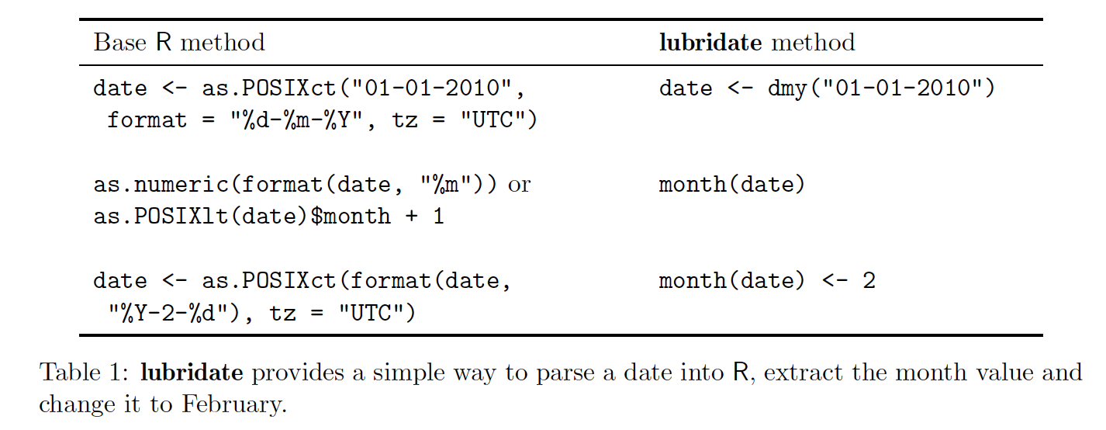
Working with strings and dates
Objectives
Learn how to manipulate strings
http://gastonsanchez.com/Handling_and_Processing_Strings_in_R.pdf
Learn some tips for working with dates

Slide 11
Functions used
paste()
tolower()
toupper()
abbreviate()
intersect()
setdiff()
substr()
grep()
gsub()
as.Date()
difftime()
ymd()
mdy()
dmy()
wday()
yday()
interval()

Slide 12
Exercise 3
Create an object ‘start_date’ with todays date as a string – ‘09282016’
Make this into a date object
Extract the month, day, and year from the date object
Determine what the date will be one week from today
How many days is it until Thanksgiving (11/24/2016)?

Slide 13
Summarizing and plotting data
Objectives
Use functions to summarize data
Learn how to plot data and tweak plots

Slide 14
Functions used
sum()
mean()
median()
mode()
sd()
quantile()
summary()
table()
aggregate
tapply()
sapply()
lapply()
plot()
boxplot()
hist()

Slide 15
Exercise 4
Make sure you set the working directory
Read in the following csv:
‘hw.dat.csv’
Summarize (mean, sd, range) of ‘lengths_mm’ and ‘weights_kg’
Summarize the two variables by date
Plot length versus weight
Use a boxplot to look at trends in lengths by date.

